Slide 1



Data Visualization Assignment - Ethnicity - BhawnaSharma - 1.0
View in Power BI
Last data refresh:
8/3/2024 2:01:21 PM UTC
Downloaded at:
8/3/2024 2:04:34 PM UTC

Slide 2
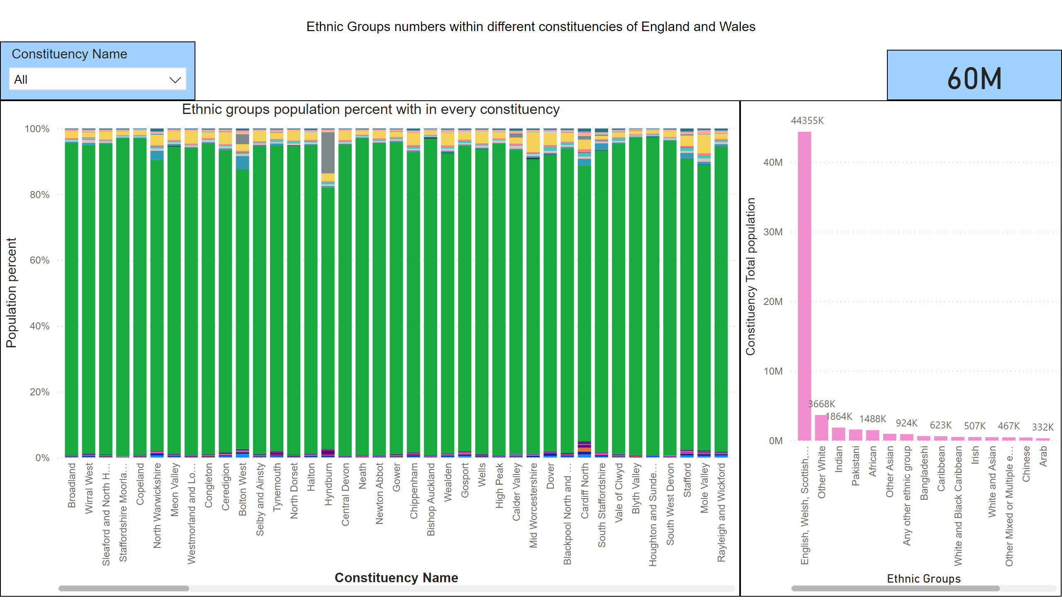
1.1
Notes:
Ethnic groups population percent with in every constituency
No alt text provided
slicer
No alt text provided
textbox
No alt text provided
clusteredColumnChart
No alt text provided
card
No alt text provided

Slide 3
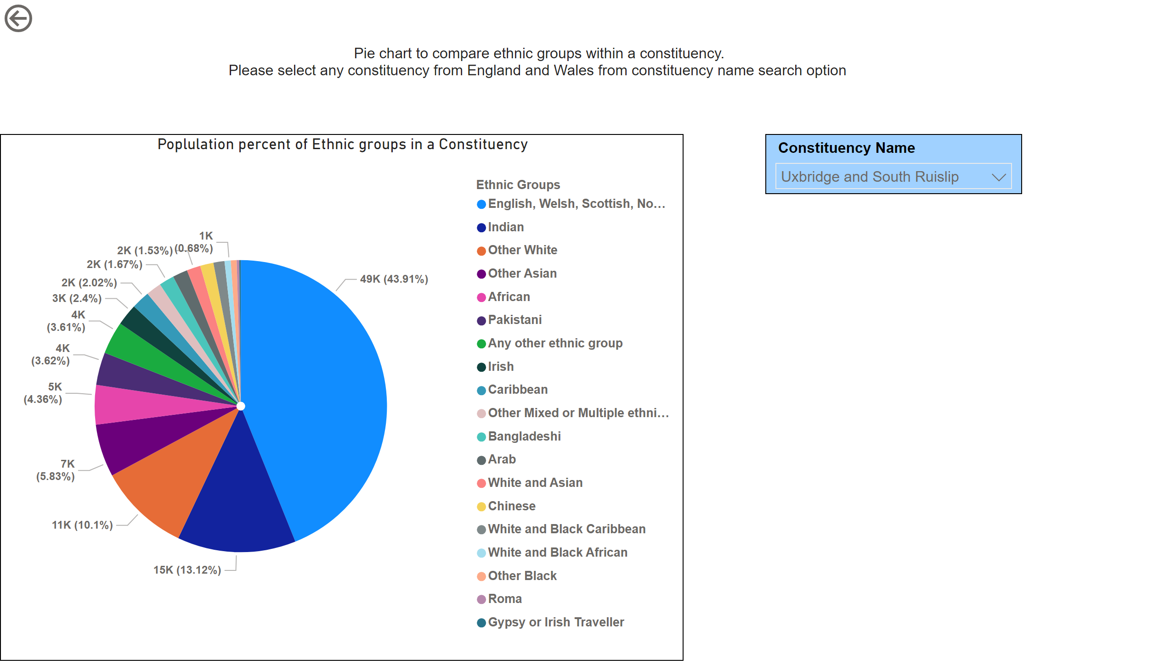
1.2
Notes:
Poplulation percent of Ethnic groups in a Constituency
No alt text provided
actionButton
No alt text provided
slicer
No alt text provided
textbox
No alt text provided

Slide 4
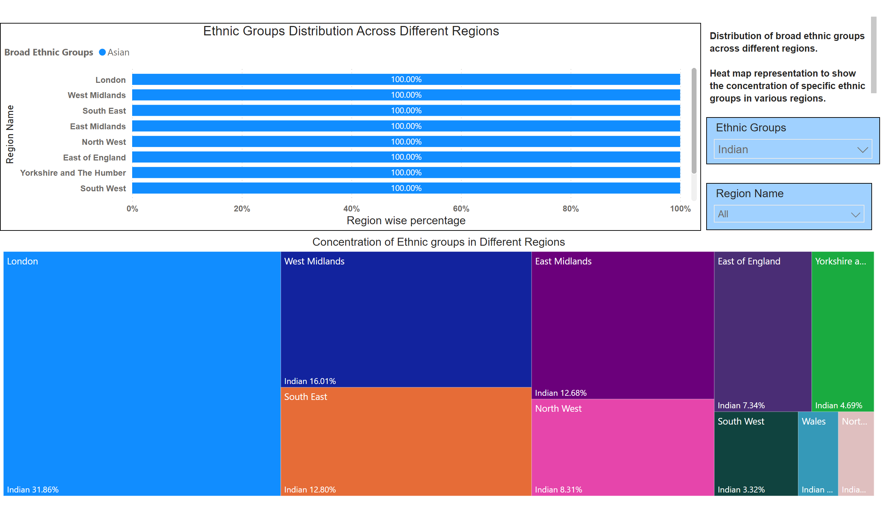
2
Notes:
Ethnic Groups Distribution Across Different Regions
No alt text provided
Concentration of Ethnic groups in Different Regions
No alt text provided
slicer
No alt text provided
slicer
No alt text provided
textbox
No alt text provided

Slide 5
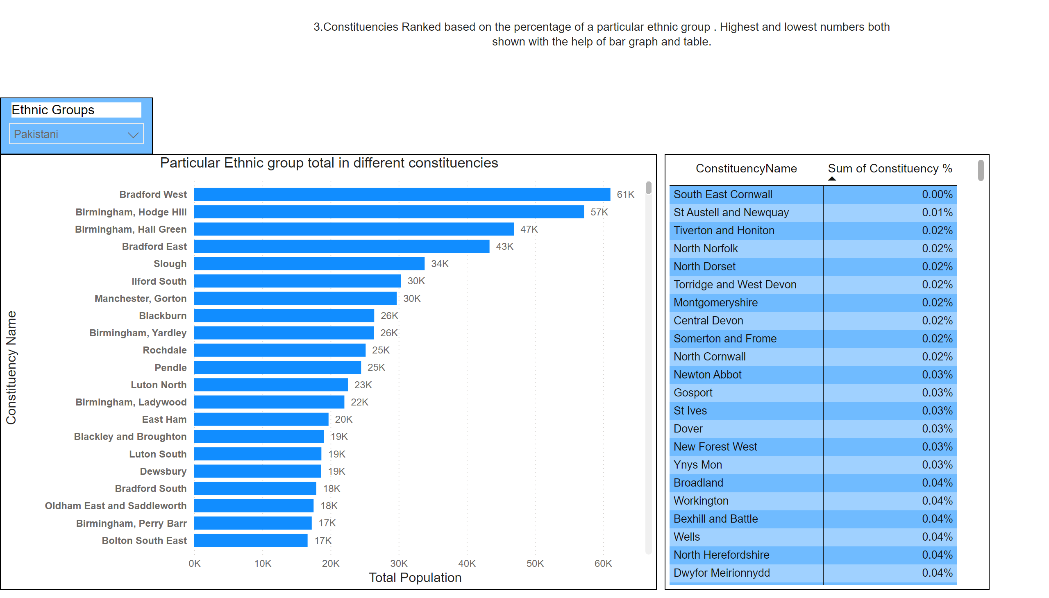
3
Notes:
slicer
No alt text provided
Particular Ethnic group total in different constituencies
No alt text provided
textbox
No alt text provided
pivotTable
No alt text provided

Slide 6
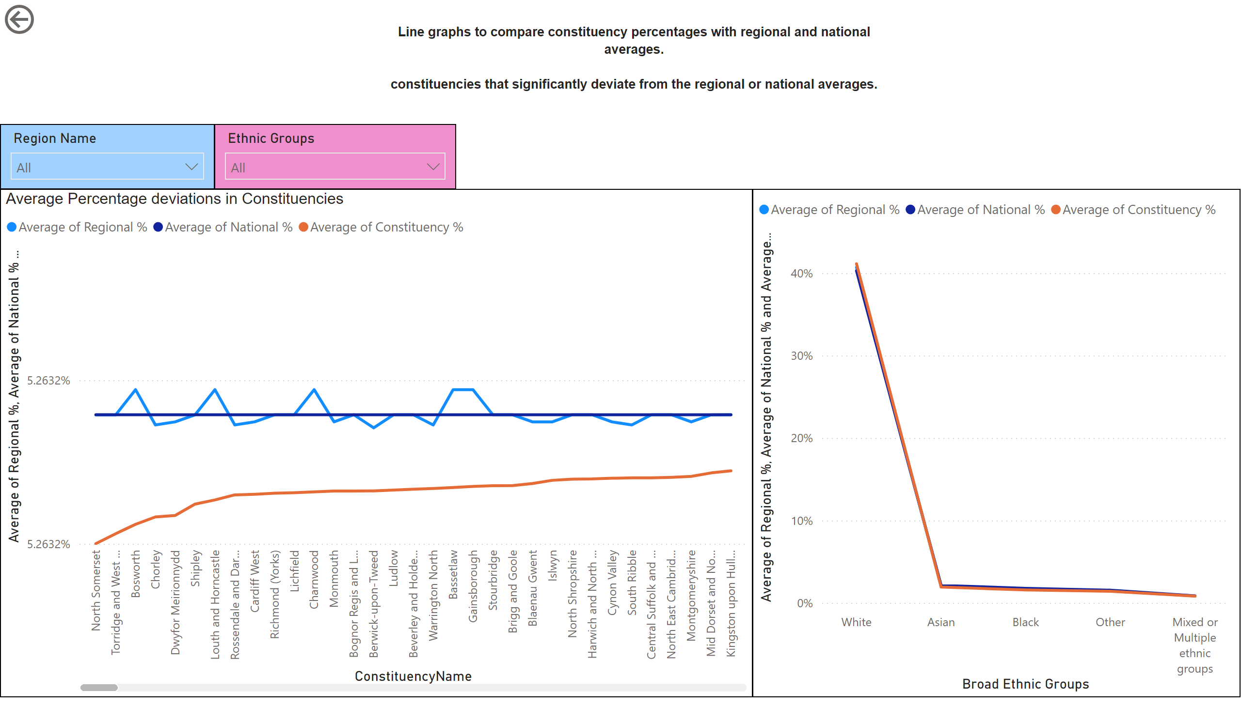
4
Notes:
lineChart
No alt text provided
actionButton
No alt text provided
Average Percentage deviations in Constituencies
No alt text provided
textbox
No alt text provided
slicer
No alt text provided
slicer
No alt text provided

Slide 7
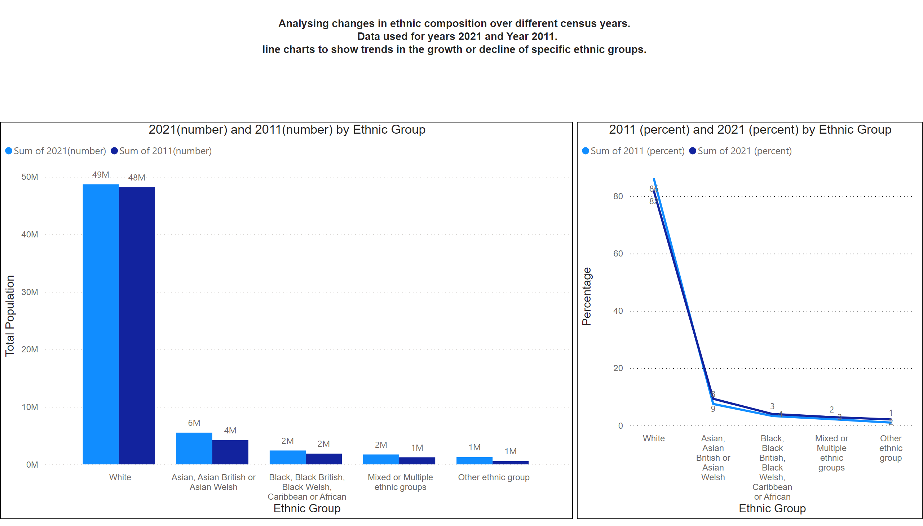
5
Notes:
2021(number) and 2011(number) by Ethnic Group
No alt text provided
2011 (percent) and 2021 (percent) by Ethnic Group
No alt text provided
actionButton
No alt text provided
textbox
No alt text provided

Slide 8
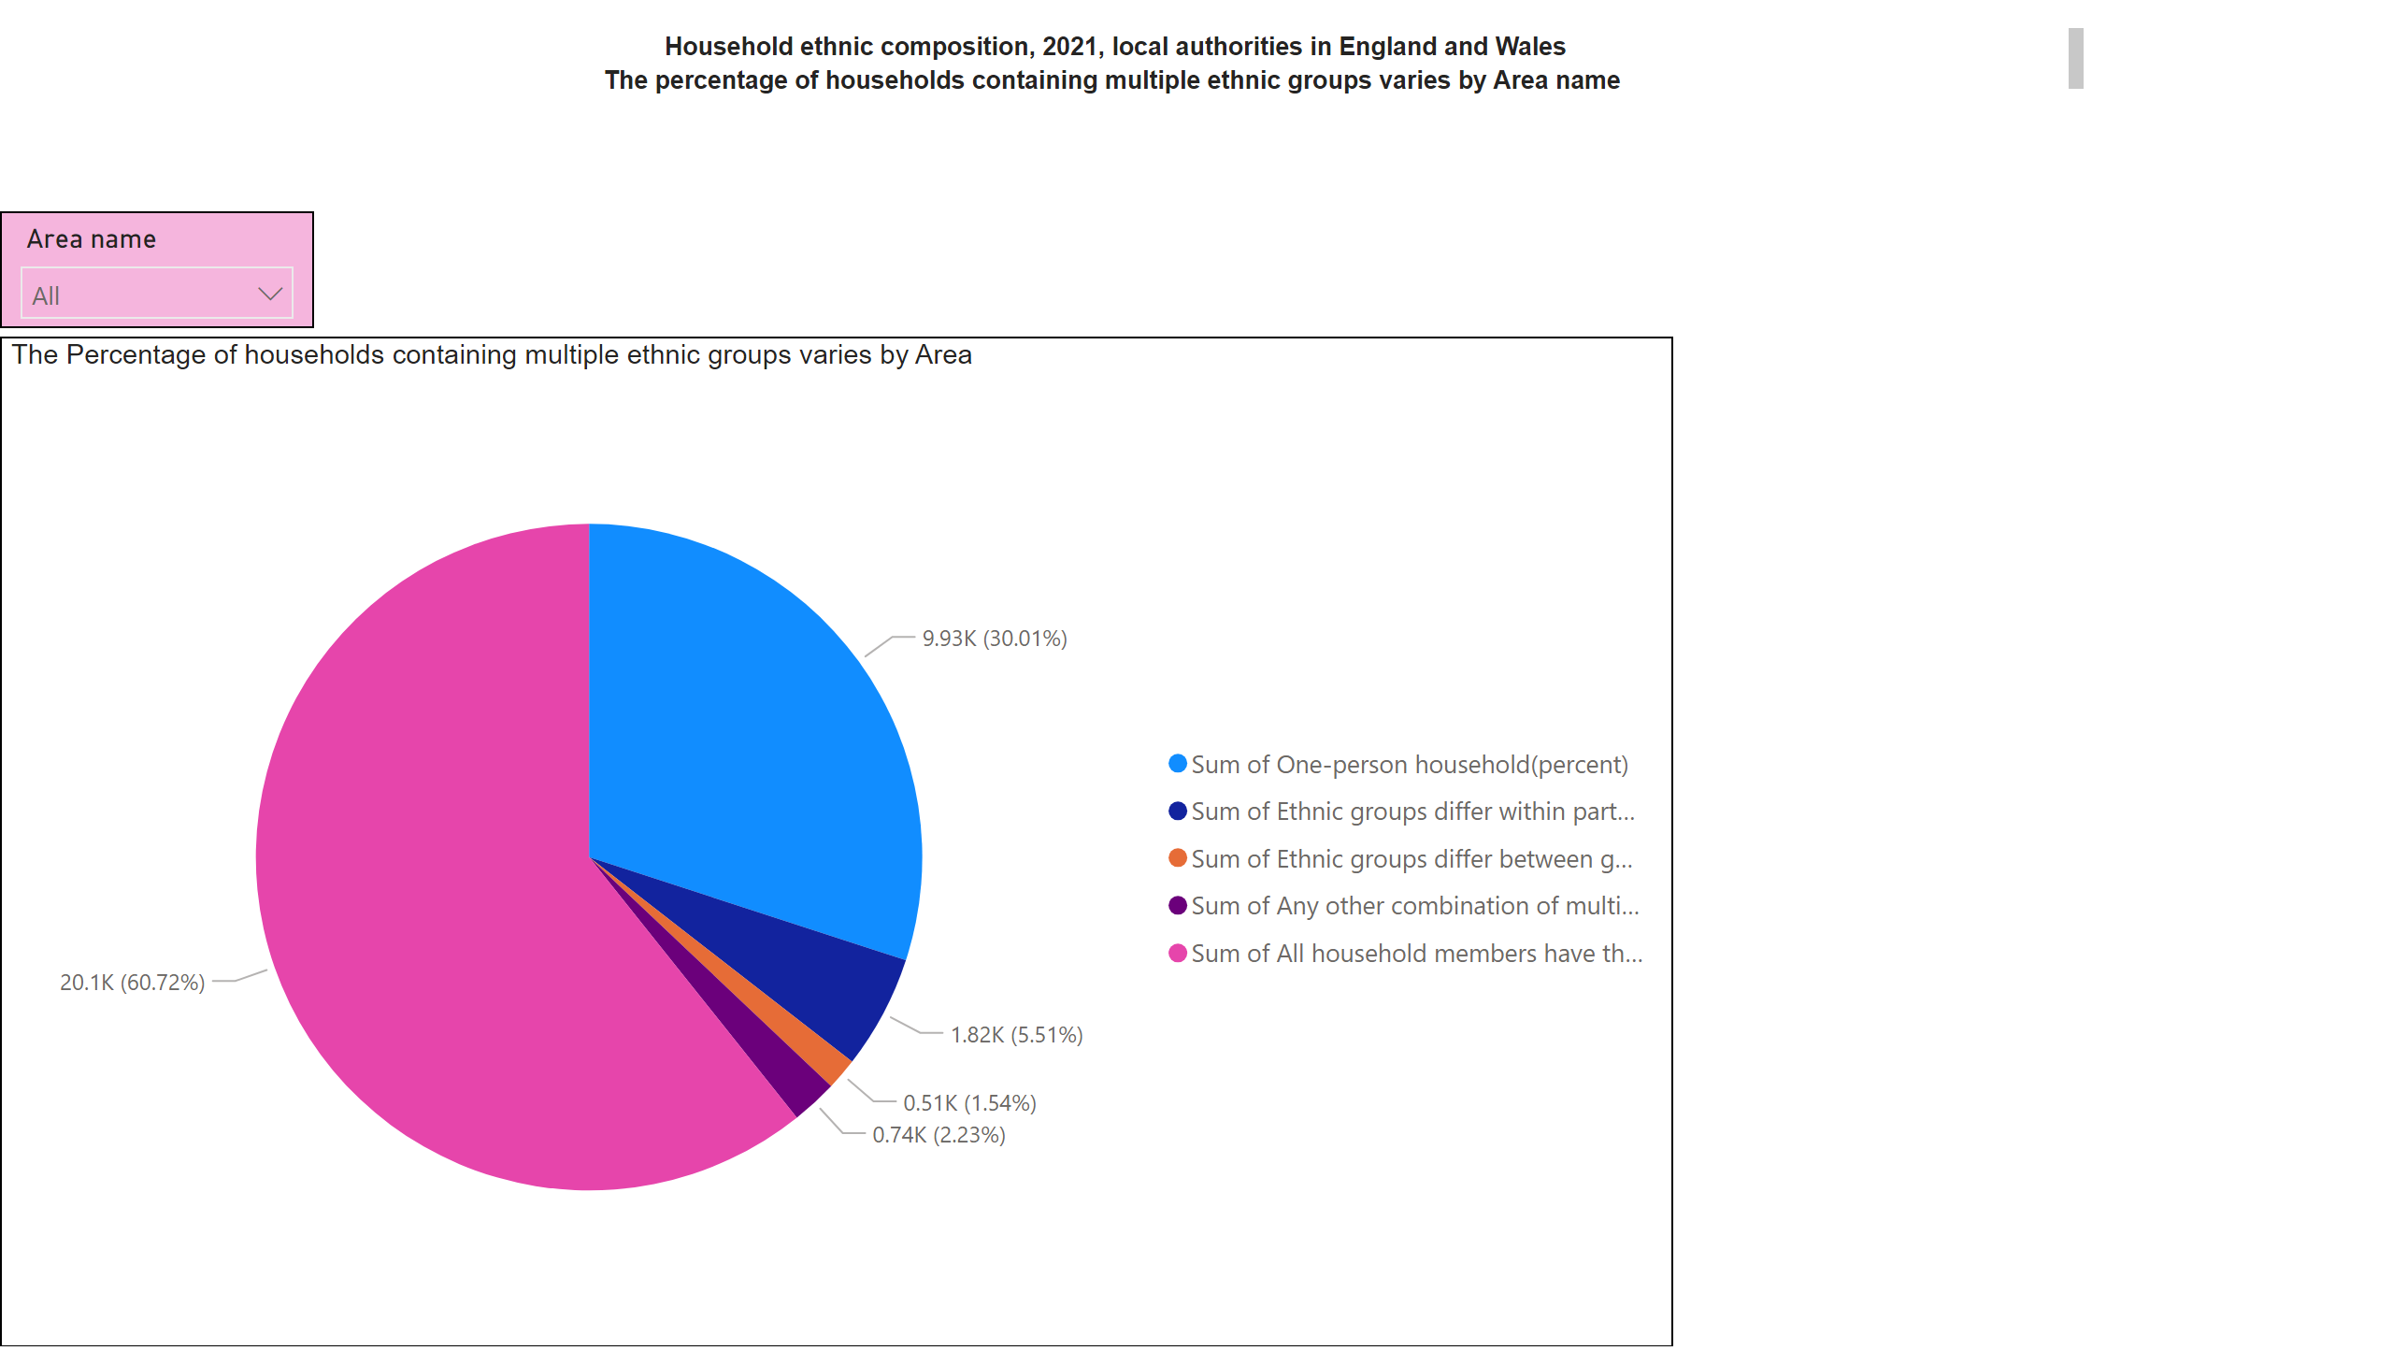
5.2
Notes:
The Percentage of households containing multiple ethnic groups varies by Area
No alt text provided
slicer
No alt text provided
textbox
No alt text provided

Slide 9
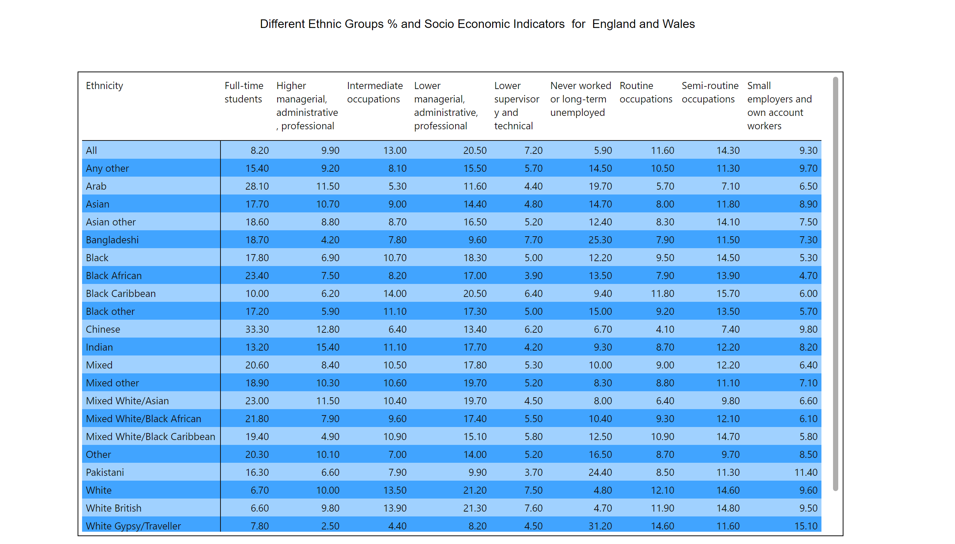
6
Notes:
Ethnic groups population percent with in every constituency
No alt text provided
textbox
No alt text provided

Slide 10
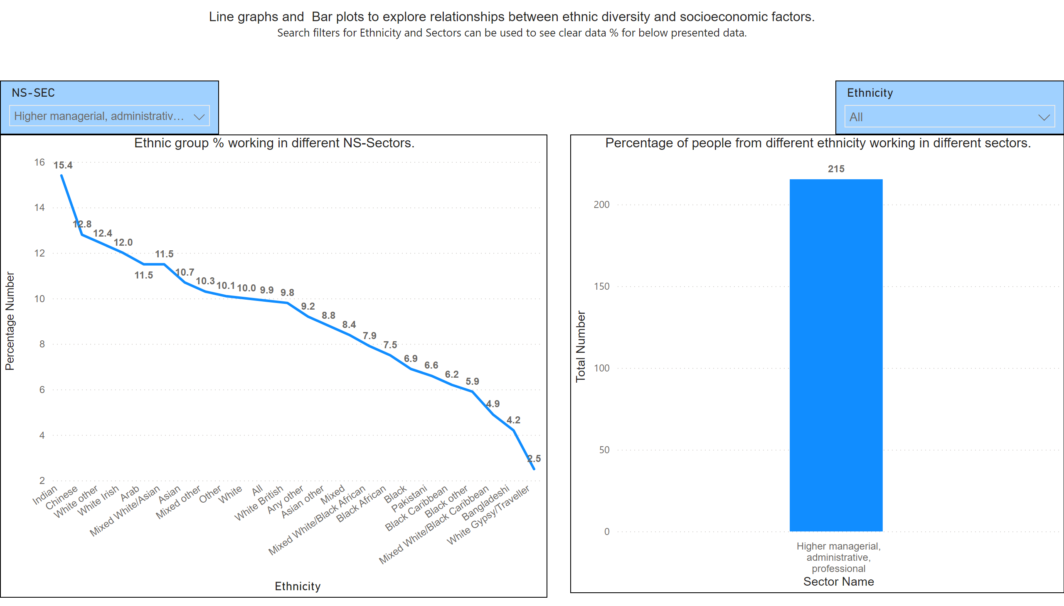
6.2
Notes:
Ethnic group % working in different NS-Sectors.
No alt text provided
slicer
No alt text provided
Percentage of people from different ethnicity working in different sectors.
No alt text provided
textbox
No alt text provided
slicer
No alt text provided

Slide 11
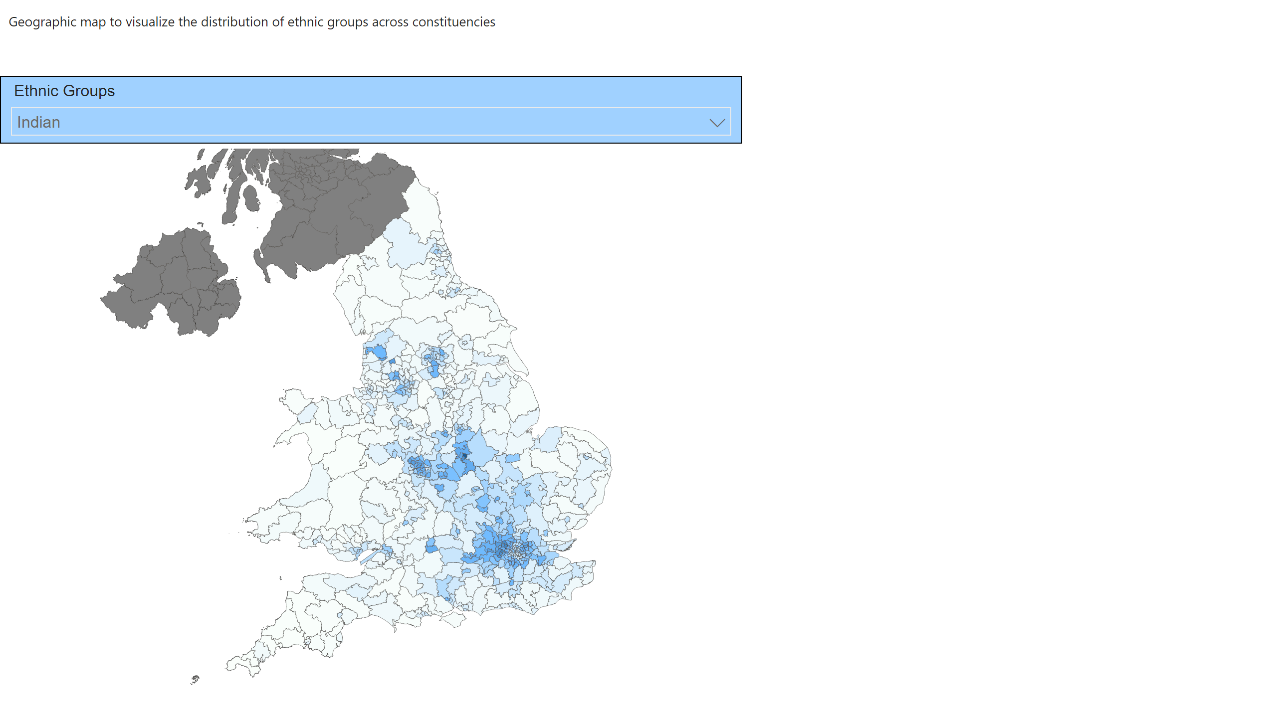
7
Notes:
Constituency % and First ConstituencyName by ONSConstID
No alt text provided
textbox
No alt text provided
slicer
No alt text provided

Slide 12
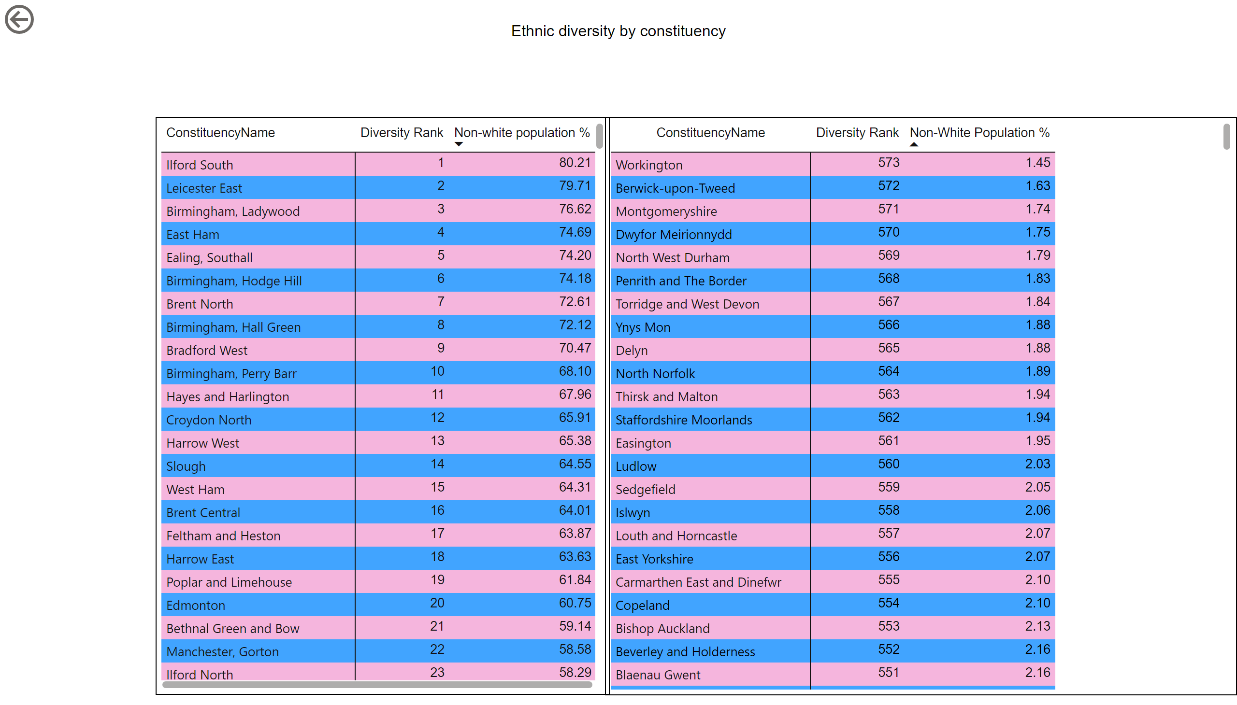
8
Notes:
Most and least diverse constituency in England and Wales
No alt text provided
textbox
No alt text provided
actionButton
No alt text provided
pivotTable
No alt text provided

Slide 13
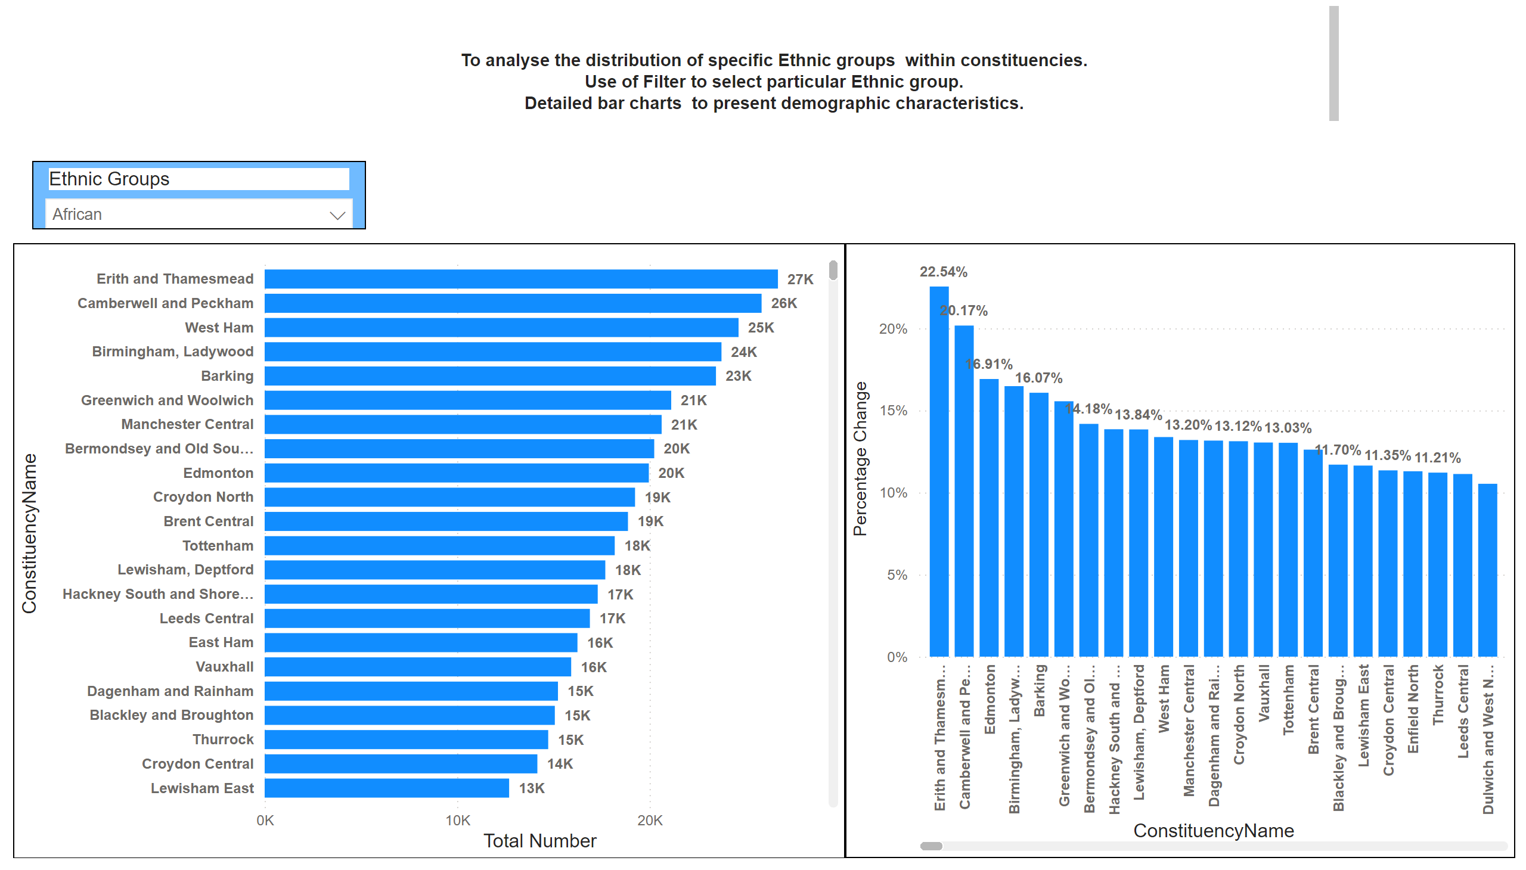
9
Notes:
slicer
No alt text provided
barChart
No alt text provided
Et Constituency % by ConstituencyName
No alt text provided
textbox
No alt text provided

Slide 14
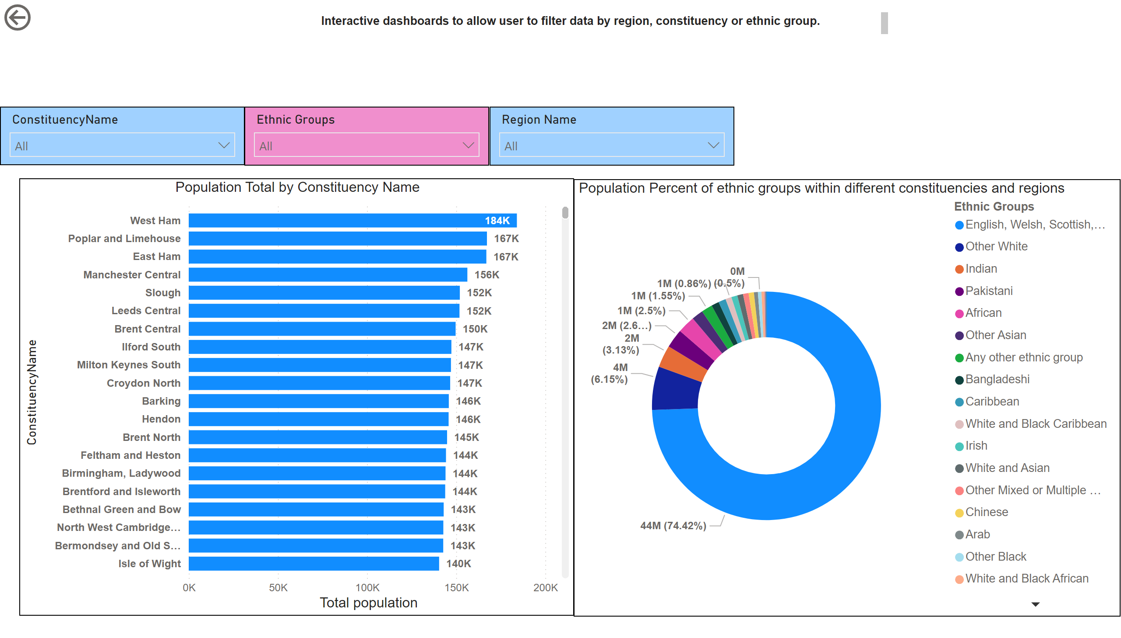
11
Notes:
slicer
No alt text provided
slicer
No alt text provided
slicer
No alt text provided
Population Total by Constituency Name
No alt text provided
Population Percent of ethnic groups within different constituencies and regions
No alt text provided
actionButton
No alt text provided
textbox
No alt text provided

